Slide 1







Stack Overflow Developer Survey 2019
ADITYA RANJAN
22-02-2024

Slide 2



OUTLINE
Executive Summary
Introduction
Methodology
Results
Visualization – Charts
Dashboard
Discussion
Findings & Implications
Conclusion
Appendix

Slide 3

EXECUTIVE SUMMARY
Data Contextualization and Analysis.
Methodology involved:
Data Gathering
Data Analysis
Data Visualization
Results are presented and supported with graphs & charts.
Discussion of overall findings and implications regarding the results.
Final conclusion of the carried out results.

Slide 4

INTRODUCTION
Stack Overflow’s annual Developer Survey 2019 is the largest and most comprehensive survey for coders around the world.
Nearly 90,000 developers participated.
Trends to predict- where are the developers going?
Characterization of developers around the globe.

Slide 5

METHODOLOGY
Collected survey data and examined its content by
Web Scraping
APIs
Request Library
Data Wrangling
Exploratory Data Analysis(EDA)
Analyzing data distribution
Handling outliers
Correlations
Data Visualization
Highlighted data distribution, relationships, the composition and the comparison of data.
Dashboard

Slide 6
RESULTS
JavaScript is widely used and Python is the fastest growing language.
MySQL is the most popular and in-demand database.
C++ and Php will loose popularity among developers in future.
Significant gender disparity is evident in the development field. 93.5% developers are male while only 6.5% are female developers.

Slide 7
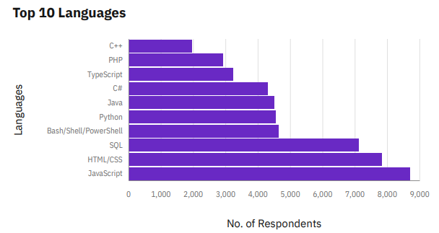
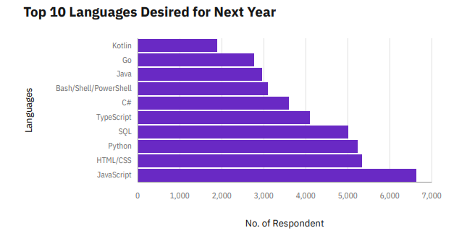
PROGRAMMING LANGUAGE TRENDS
Current Year
Next Year

Slide 8
PROGRAMMING LANGUAGE TRENDS - FINDINGS & IMPLICATIONS
Findings
JavaScript is the most preferred language amongst coders.
Python is the fastest growing language.
Noticed growing interest in TypeScript.
Implications
Preference of C++ and php can extinct among the coders in the coming years.
Kotlin and Go have become new area of interest for the coders.

Slide 9
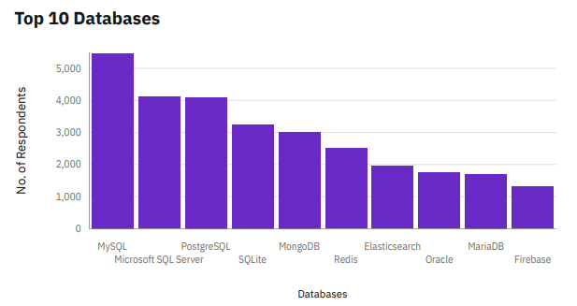
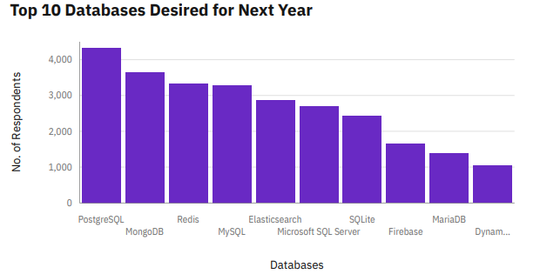
DATABASE TRENDS
Current Year
Next Year

Slide 10
DATABASE TRENDS - FINDINGS & IMPLICATIONS
Findings
MySQL is most used database.
Rapid growth of interest in PostgreSQL and MongoDB.
The popularity of Oracle has waned among coders.
Implications
Microsoft SQL Server and SQL Lite losing ground in market.
Establishment of PostgreSQL and MongoDB in the market.

Slide 11

DASHBOARD
Github Link
https://github.com/ADITYARANJANUS/IBM-Capstone-Project-Dashboard/blob/main/IBM%20Cognos%20Analytics%20Capstone%20Project%20Dashboard.pdf

Slide 12
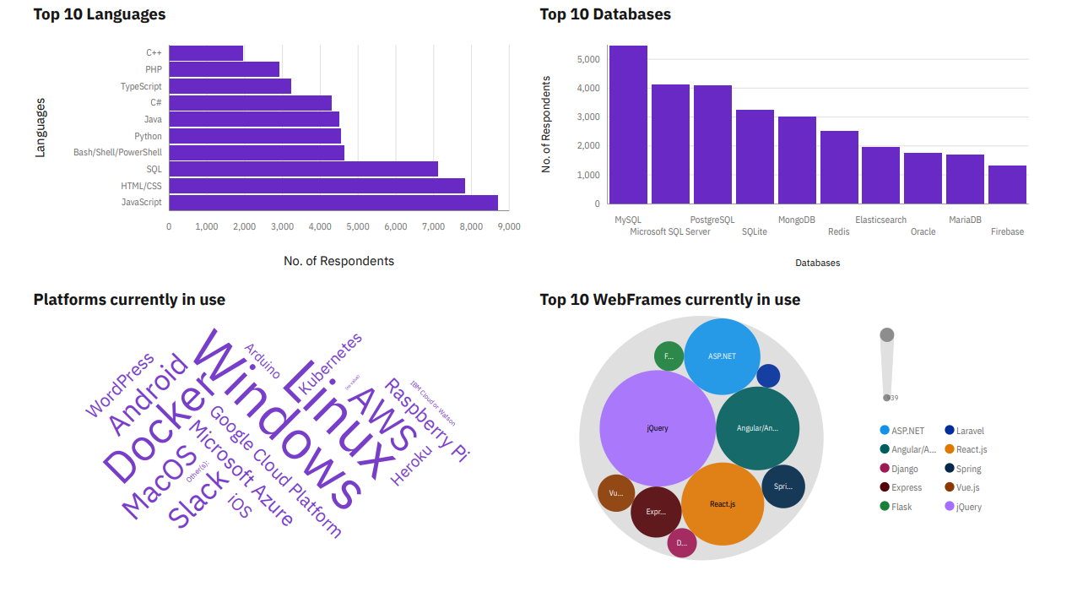
Current Technology Usage

Slide 13
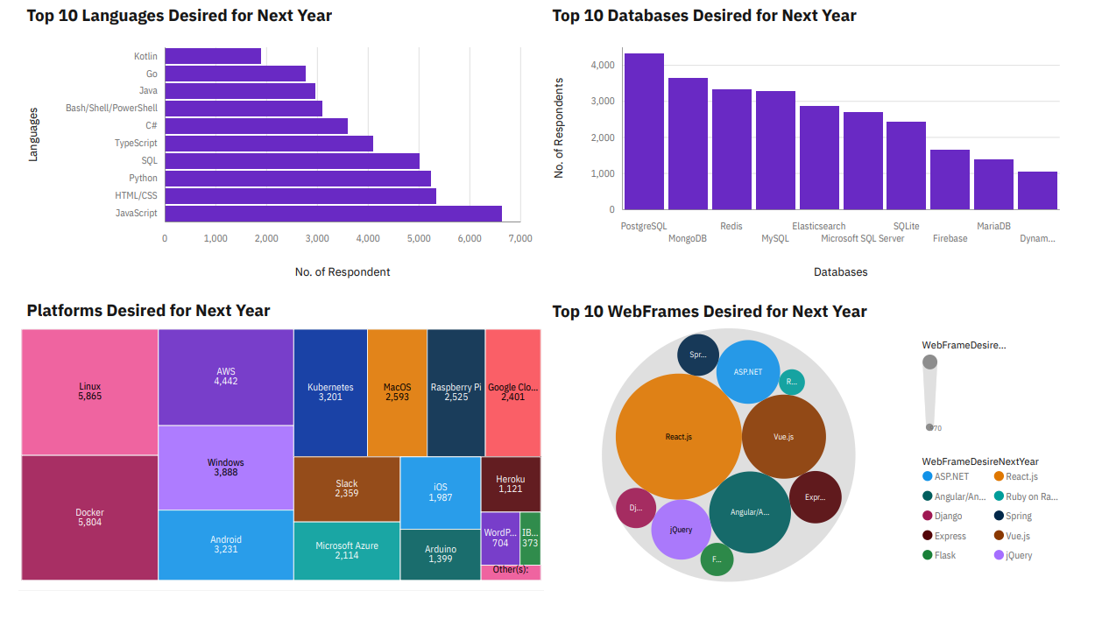
Future Technology Trends

Slide 14
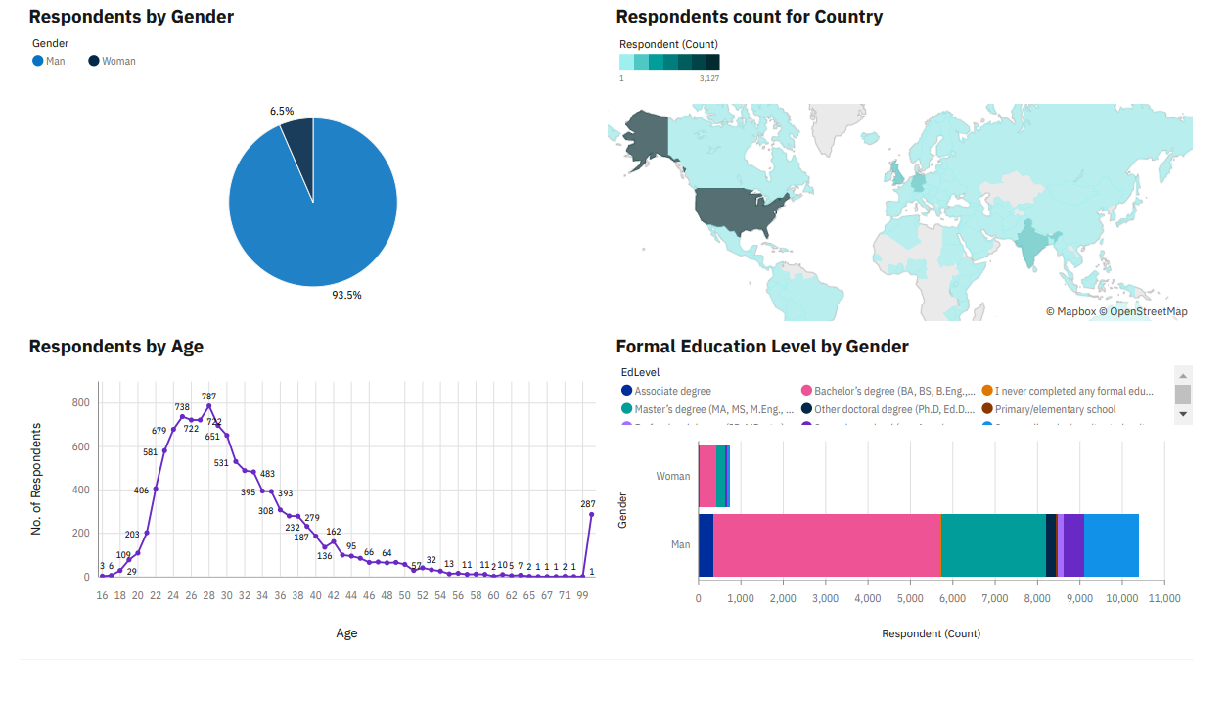
Demographics

Slide 15
DISCUSSION
According to trends, which is the top most language among coders?
According to trends, which is the top most database among coders?
What’s the ratio of male and female coders in the development industry?
Highest education of the coders in the current industry?

Slide 16
OVERALL FINDINGS & IMPLICATIONS
Findings
Around 90% coders are male in the coding field.
JavaScript is widely used and Python is the fastest growing language.
Developers are mostly located in developed countries, like the USA.
WebFrames like ReactJS, Angular to be widely used in future.
Implications
Decrease in number of jQuery users.
Platforms like Docker, AWS, Kubernetes will be used widely by coders in the upcoming years.
Majority of young developers are without postgrad degree.

Slide 17

CONCLUSION
Developers are people with marked characteristics.
They are evolving at every stage, according to the market standards/requirement.
Accessibility of labor market should be spread across the country under development.
Good idea of popular tools, languages, and platforms can be a plus point for the emerging coders.

Slide 18
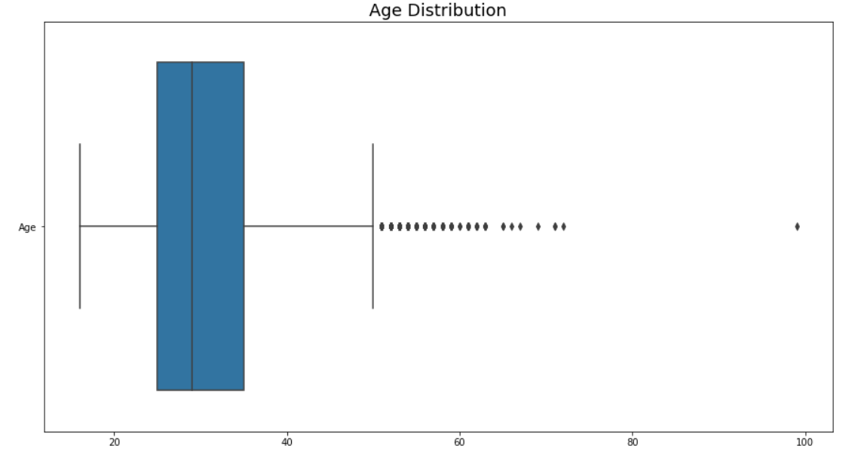

APPENDIX
Average age of people working in development field is of 30 years.

Slide 19
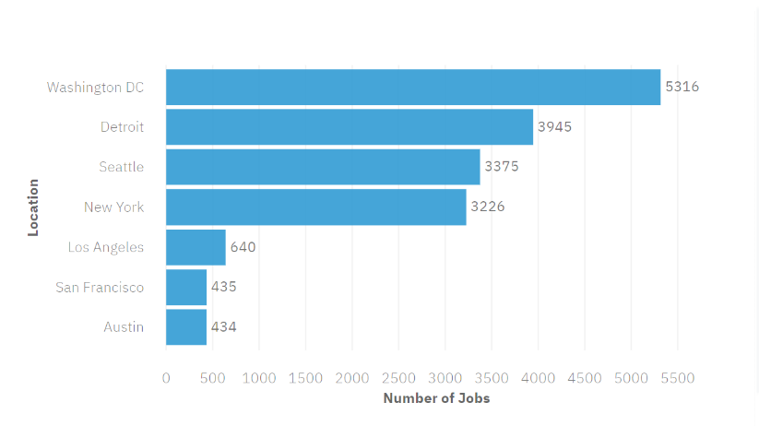
JOB POSTINGS

Slide 20
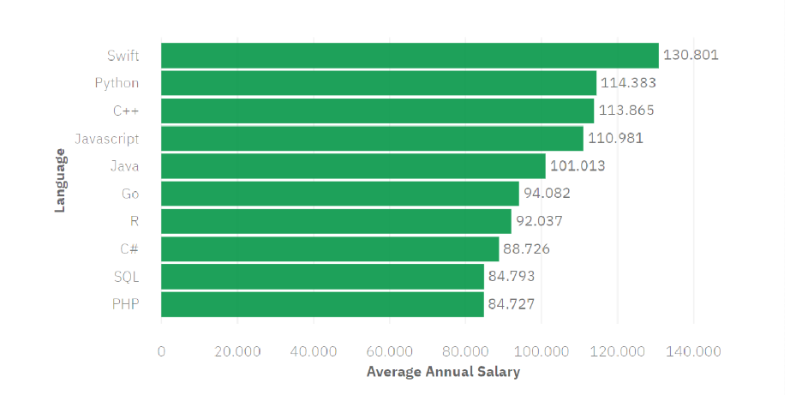
POPULAR LANGUAGES

